Slide 1
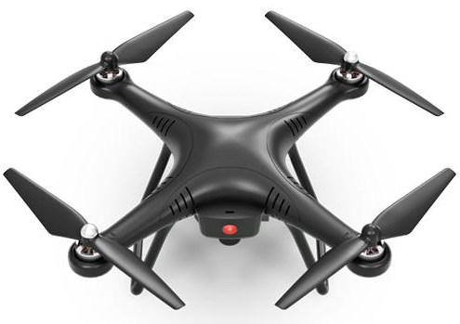
Adept
Relay
Nicole Villa
Juan Ramos
Jimmy Phuong
Julio Valdez
Mesh Network App for Communications During Natural Disasters
Notes:
Insert a drone

Slide 2
AdeptRelay
Problem- Coupling Communication & Data Collection: During & After Disasters
The AdeptRelay Way (Solution)
Proof of Concept
Implementation (next steps)

Slide 3
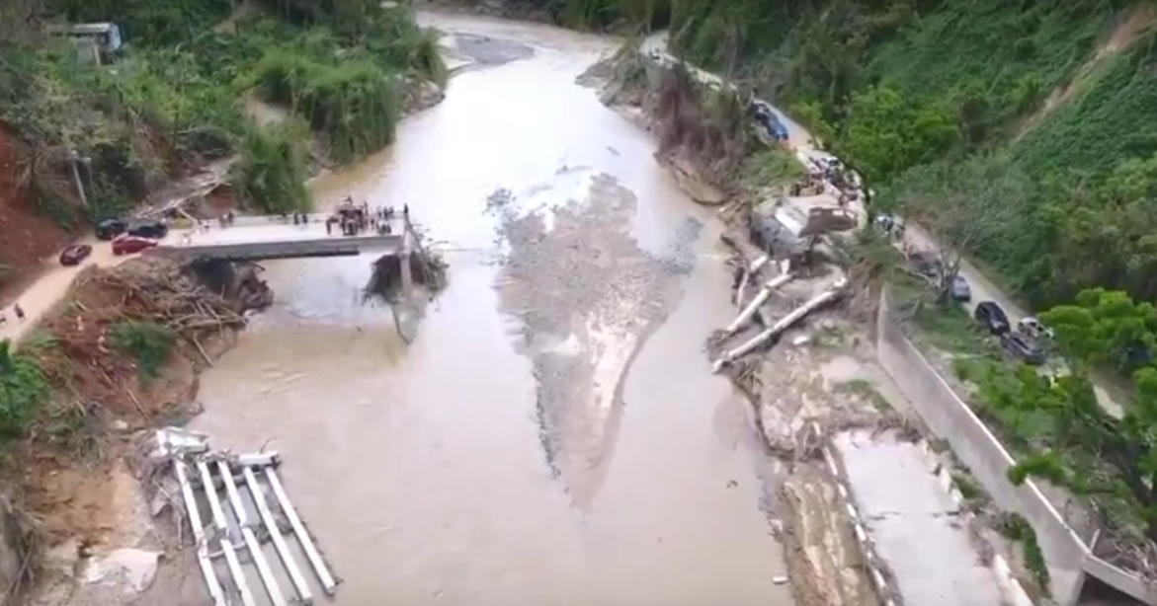
Worse Case Scenario: Utuado Bridge Puerto Rico
Anybody Out There?
Notes:
Locals in Rural P.R’s Have Their Main Bridge Demolished by Maria. Supplies sent Via Makeshift Zip Line with Shopping Cart.

Slide 4

Lorena in Utuado...
“I need an ambulance. I am pregnant, my water broke. The road has collapsed. I can’t move my car! Please help!” - 109 characters
Notes:
Drone
Wifi from a hotspot
bridgefy
Give people a way to send a communication
It wasn’t a big success. The drone needed to get as close as 15 ft away from the devices. The drone ran out of batteries before many of the people could finish downloading.

Slide 5
How to Couple Communication & Data Collection: During & After Disasters?
Communication Drives Data Collections; Which Directly Affects Rapid Action -
Real time data-collection serves three purposes.
1. Community members immediately know other members’ high priority needs
2. Archive time-sensitive data that can fuel machine Learning
3. World community knows how to strategically assist empowered locals at the earliest/safest time possible

Slide 6
The AdeptRelay Way (solution)

Slide 7
The AdeptRelay Way (Solution)
Government sends out PSA informing communities to download the app
PSA Alerts are targeted for high e.g: weather, resources, medical, etc.
Drones equipped with raspberry pi (bluetooth / wi-fi connection) fly over pre-determined community hubs (churches)
Emojis (8bits) ease burden on memory constraints
This effectively couples communication which drives data collection

Slide 8
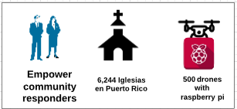
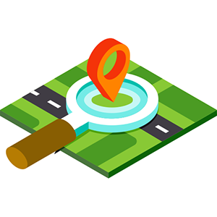
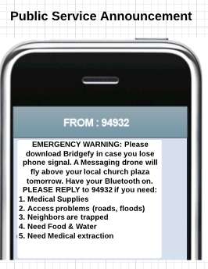
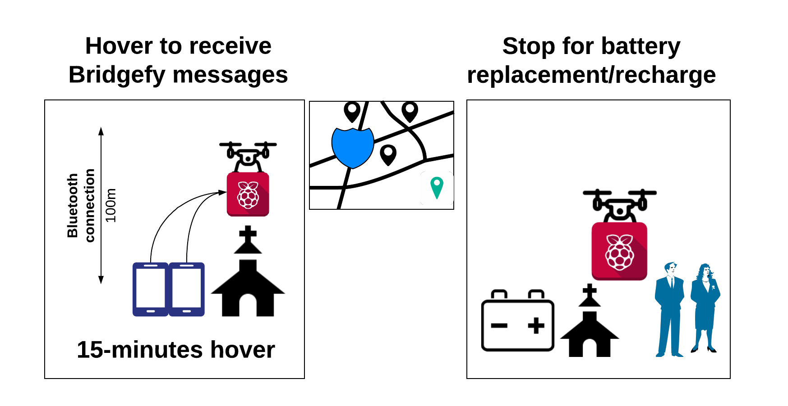
Notes:
Drones will not fly over 6,244 churches. That is just the TAM and means that it’s a large market but top churches will be decided upon.

Slide 9
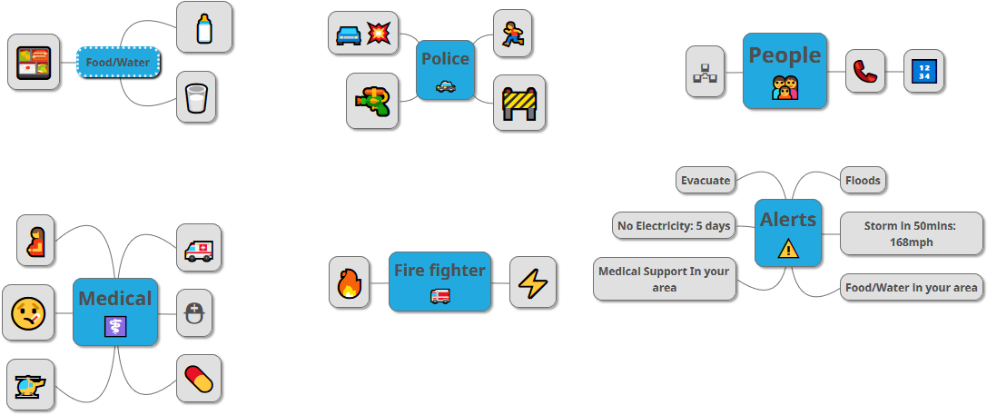
Emoji language shortens Lorena’s message.

Slide 10
Proof of Concept

Slide 11
Implementation (next steps)
Integrate Android & iOS devices
Integrate AlleyOop, FireChat, and Bridgefy for store-and-forward messaging
Use case testing
Data storage from multiple devices
Audible noise so when drones arrive at locations that inattentive people do not miss drone

Slide 12
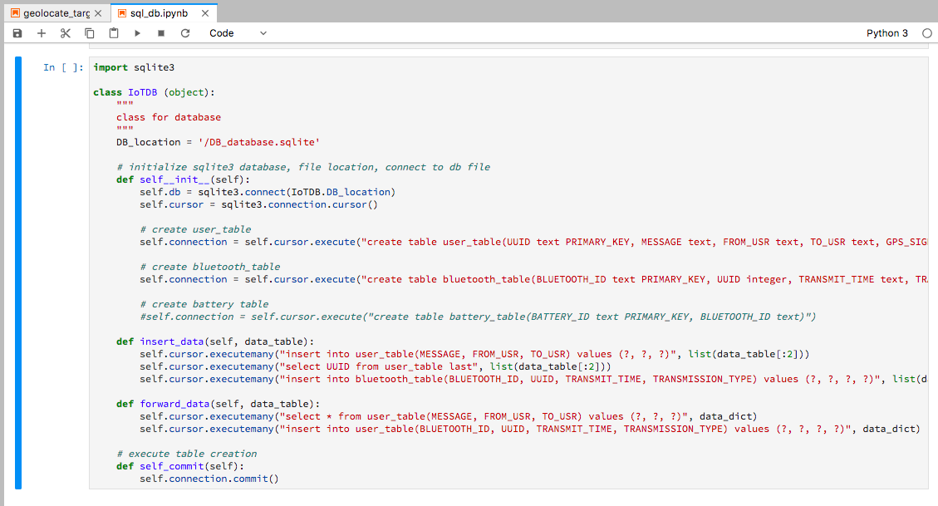
Notes:
We considered the possible memory backlog that could happen. When apps like AlleyOop retain too much memory in cache, no new messages may be receivable. So, we tried introducing a simple, sqlite database schema.
We ended up introducing this to AlleyOop and prepared it for Bridgefy as well.

Slide 13
Questions?

